Slide 1

INDUSTRIAL FIRE EXTINGUISHER
Project group number : 8
Course name : Introduction to Electrical and Electronics Engineering

Slide 2
TEAM MEMBERS
Roll Number | Name | Contribution | % Contribution (sum =100%)
AM.EN.U4AIE22113 | Shanmukha .Ch | Coding & Software Part | 25%
AM.EN.U4AIE22103 | Sanjeev .A | Assembling and Research of Papers | 25%
AM.EN.U4AIE22160 | Manasa Raj .D | Documentation and Assembling | 25%
AM.EN.U4AIE22133 | Parthiv .M | Circuit connection and Software Part | 25%

Slide 3
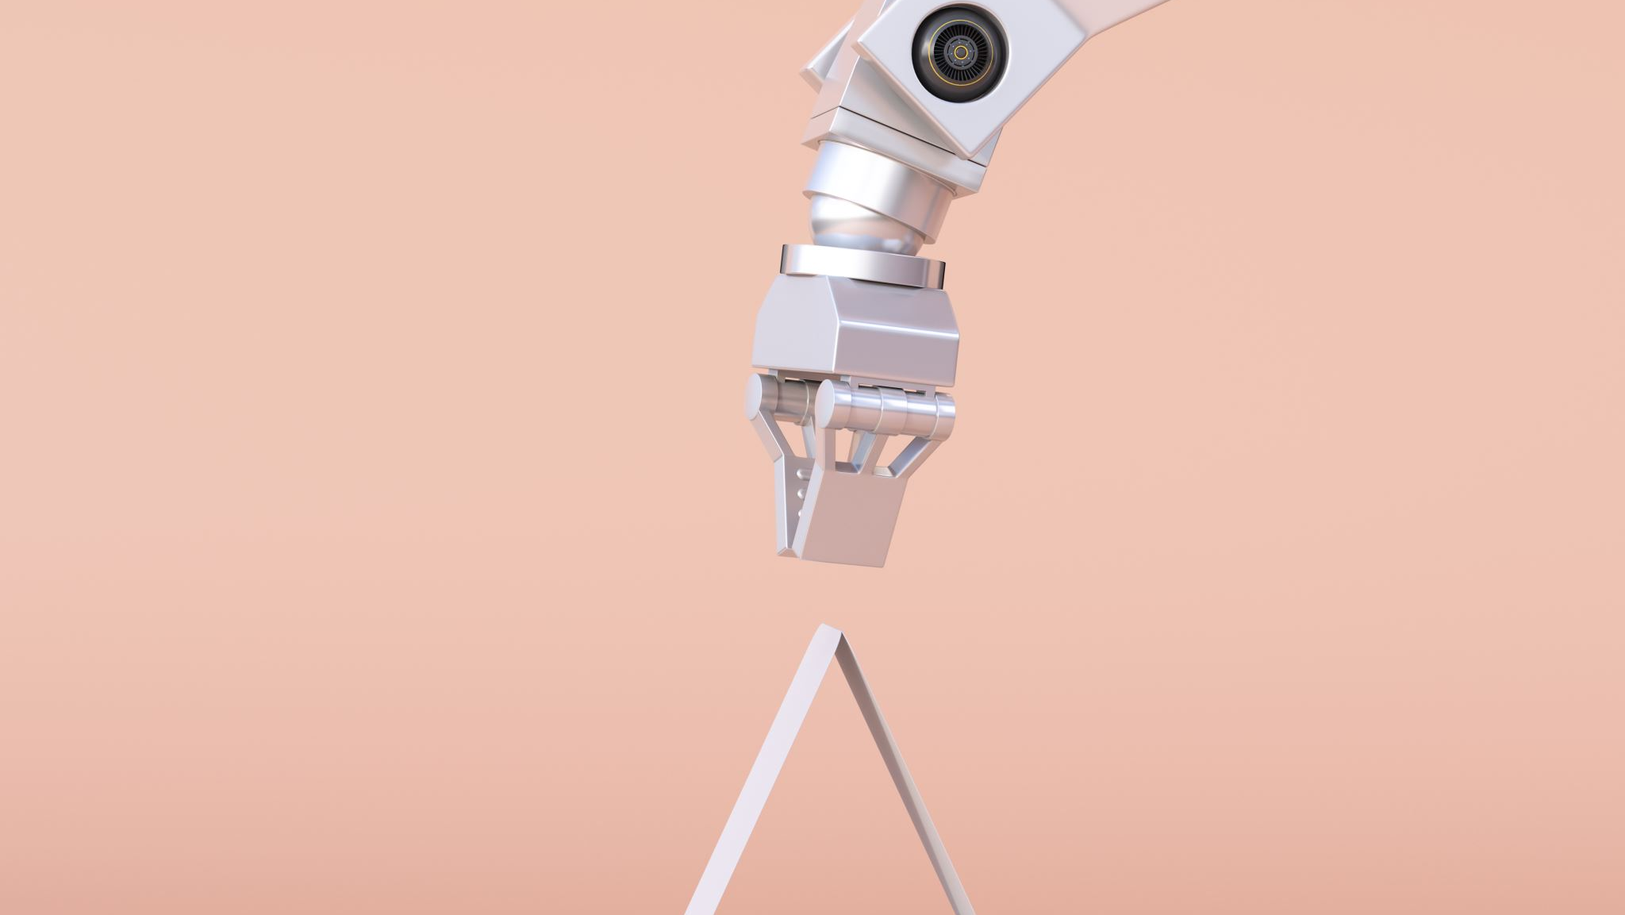
INTRODUCTION
INDUSTRIAL FIRE EXTINGUISHER ROBOT PROJECT using flame sensors is a robotic device that is designed to detect and extinguish fires automatically and intimate the user. The robot typically consists of an Arduino microcontroller, a flame sensor, a water pump, Node MCU, LCD display, and a servo motor.
It is a Challenging and Rewarding project. Building a fire fighting robot requires students to learn about a variety of different engineering concepts, including electronics, programming, and mechanics. It is a great way for students to test their skills and knowledge, and to see what they are capable of. Fire fighting robots have the potential to save lives and property. By working on this project, students can learn about the latest fire fighting technologies and how they can be used to protect people and property.
The specific Objectives of the Arduino-based fire fighting robot project include:
-->To develop a robot that can detect fires using fire sensors.
-->To develop a robot that can extinguish fires using a water pump.
-->To develop a robot that can Transfer in a variety of environments.

Slide 4
PROBLEM STATEMENT
Industrial fire extinguisher address a number of problems associated with traditional fire fighting methods. These problems include:
Firefighting is a dangerous occupation, and firefighters are often exposed to hazardous conditions, such as smoke, heat, and flames. Industrial fire extinguisher can help to reduce the risk of injury to firefighters by allowing them to fight fires from a safe distance.
Fires can occur in difficult-to-access areas, such as complex machine parts, underground tunnels, and chemical plants. Arduino-based fire fighting robots can help to extinguish fires in these areas, which would otherwise be inaccessible to firefighters.
Traditional fire fighting methods, such as hoses and ladders, can be inefficient in certain situations. For example, hoses can be difficult to maneuver in tight spaces, and ladders can be dangerous to use in high-rise buildings. Arduino-based fire fighting robots can be more efficient in these situations, as they can navigate through tight spaces and reach high-up areas.

Slide 5
METHODOLOGY
FLAME DETECTION:
The robot moves around and search for the signs of flame.The robot will search for flames using the three flame sensors placed in front of the robot. When a fire is detected in the flame sensors ( side sensors with range of 200mm) that is placed on either ends of the robot, the robot will turn in the direction of the flame and moves forward until the value of short range flame sensor (center sensor with range of 200mm) is lower than the cutoff value. When the value of the center flame sensor is below cutoff value, then the robot will stop and initiate the pumping action.
DATA TRASFER:
In the case of fire is detected the Sensor the data Will be transferred to the Telegram API containing the direction of fire, the level of the extinguisher ,The Approximate time that extinguisher can last and the Warning Signal will be Transferred Over the Network.
PUMPING ACTION:
Once the pumping action is initiated, the motor for the pump will be enabled and sprays the water. This is done until the flame is bought down to ground level. The robot will keep moving around in search of a possible fire.

Slide 6
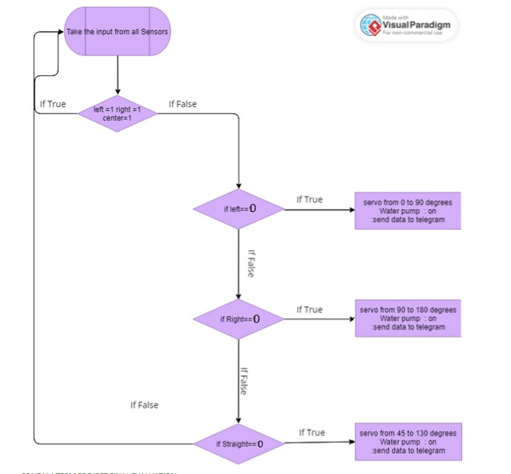
Flow Chart
0

Slide 7

SDG ADDRESSED
SDG 3 - Ensure healthy lives and promote well-being By helping to keep firefighters safe, reduce the amount of water and foam that is wasted, these robots can help to save lives and improve the health and well-being of people around the world.
SDG 8 - Decent Work And Economic Growth By helping to protect people and property, create jobs, and train firefighters, these robots can help to promote economic growth and development in developing countries.
SDG 9 - Industry, Innovation and Infrastructure By helping to develop new technologies, and train firefighters, these robots can help to promote industrial development and innovation.
SDG 11 - Sustainable cities and Communities These robots can help to make cities more inclusive, safe, resilient, and sustainable.

Slide 8
LITERATURE REVIEW
This literature review focuses on the Industrial fire extinguisher robot project, which utilizes the Arduino microcontroller platform to develop an autonomous fire extinguishing system, transfers the data using the NodeMCU.
1. Robot Mobility:Fire fighting robots must be able to move efficiently in complex and hazardous environments. Different locomotion mechanisms have been employed based on the specific requirements of the project. Wheeled systems provide stability and maneuverability on flat surfaces, while tracked systems offer better traction on uneven terrain but may have limitations in terms of speed and payload capacity.
2 Fire Extinguishing Mechanisms:Effective fire suppression mechanisms are essential for fire fighting robots. Water-based systems, such as water cannons or sprinklers, are commonly used due to their availability and effectiveness. Foam-based systems, which create a layer of foam to smother the fire, are also employed.

Slide 9
LITERATURE REVIEW
It is self-propelled, which means that it can move around autonomously without the need for human assistance. This is important in a fire-damaged environment, where it may be dangerous for humans to enter.[1].
It is equipped with a variety of sensors, including a flame sensor, an infrared sensor, and a temperature sensor. This allows the robot to detect fires and measure the temperature of the fire.[2]
simulation and has been shown to be effective in coordinating the actions of aerial and ground robots for fire detection and extinguishing missions[3]
The flame sensor detects fires and sends a signal to the IoT device. The IoT device then sends a signal to the water cannon, which discharges water onto the fire. The robot is also equipped with a camera, which allows it to navigate around the fire and avoid obstacles.[4]
The robot is equipped with a flame sensor, which detects fires by measuring the amount of infrared radiation emitted by a fire. When the flame sensor detects a fire, it sends a signal to the Arduino microcontroller. The Arduino microcontroller then controls the water pump to discharge water onto the fire.[5]

Slide 10
LITERATURE REVIEW
The robot is also equipped with a servo motor, which is used to control the robot's movement. The servo motor allows the robot to navigate around obstacles and to approach fires.[6]
The Paper focuses on flame detection sensor technologies, obstacle avoidance techniques, and Arduino's role in robotics.[7]
The robot is also equipped with a flame sensor, which detects fires by measuring the amount of infrared radiation emitted by a fire. When the flame sensor detects a fire, it sends a signal to the Arduino microcontroller. The Arduino microcontroller then controls the water pump to discharge water onto the fire.[8]
The obstacle avoidance sensors detect obstacles in the robot's path and allow the robot to avoid them. This prevents the robot from colliding with obstacles and damaging itself.[9]
The paper describes the development of an IoT-based fire alarm navigation system that uses a fire alarm, a GPS module, a GSM module, and a display to help firefighters navigate to the location of a fire.[10]
The IoT module allows the robot to communicate with other devices and systems. This allows the robot to receive information about the environment, such as the location of fires, and to send information about its own status, such as its battery level and the amount of water remaining in its tank.[11]

Slide 11
LITERATURE REVIEW
The artificial intelligence module allows the robot to make decisions about its own behavior. This allows the robot to autonomously detect and extinguish fires, even in complex and unpredictable environments.[12]
The Arduino based fire fighting robot is a valuable tool for fire prevention and fire suppression. It can be used to autonomously detect and extinguish fires in dangerous or inaccessible areas. This can help to save lives and property.[13]
This paper mainly focuses on the Arduino can be used to control the robot's movement, sensors, and actuators. It can also be used to communicate with other devices, such as a fire alarm system.[14]
The Raspberry Pi can be used to control the robot's movement, sensors, and actuators. It can also be used to communicate with other devices, such as a fire alarm system.[15]
The Autonomous Fire Fighting Robot is a promising approach for fighting fires in hazardous environments. The robot is equipped with a variety of sensors and actuators, which allows it to perform a variety of tasks related to fire detection and extinguishing. The robot is also autonomous, which means that it can operate without human intervention. This makes the robot a safe and effective way to fight fires in hazardous environments.[16]
The paper proposes a new design for a fire fighting robot that is based on an Arduino microcontroller. This makes the robot relatively easy to program and modify.[17]

Slide 12
LITERATURE REVIEW
A prototype of Fire Fighting Robot (FFR) using LEGO Mindstorm is proposed for disaster management, which has the functionality of quick movement inside a building, detecting obstacles and locating the fire on its way [18]
The robot can degasify hazardous gases. This would allow the robot to neutralize the effects of a fire and make it safe for humans to enter the area.[19]
The robot is equipped with a camera that helps it navigate around obstacles. This is an important feature for a fire extinguishing robot, as it allows the robot to avoid obstacles and reach fires that are in difficult-to-access areas.[20]

Slide 13
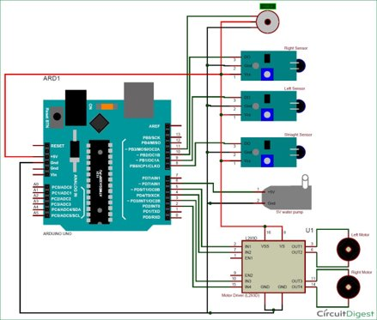
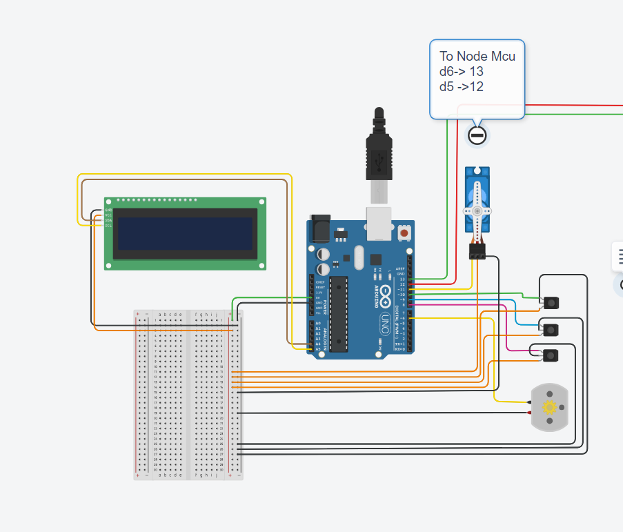
PROPOSED MODEL
The circuit diagram or required flow chart for implementation of the project.

Slide 14
COMPONENTS REQUIRED
COMPONENT NAME​ | QUANTITY​ | ESTIMATED PRICE (IN RS.)​
Arduino board ​ | 1​ | 350/-​
Fire sensor ​(IR) | 3​ | 150/-​
Mini DC Submersible Pump​ | 1​ | 120/-​
L293D Motor Driver module​ | 1​ | 130/-​
Servo Motor (SG90)​ | 1​ | 200/-​
Robot chassis​ | 1​ | 400/-​
LCD Display | 1 | 200/-
I2C Module | 1 | 300/-
Node MCU | 1 | 350/-

Slide 15
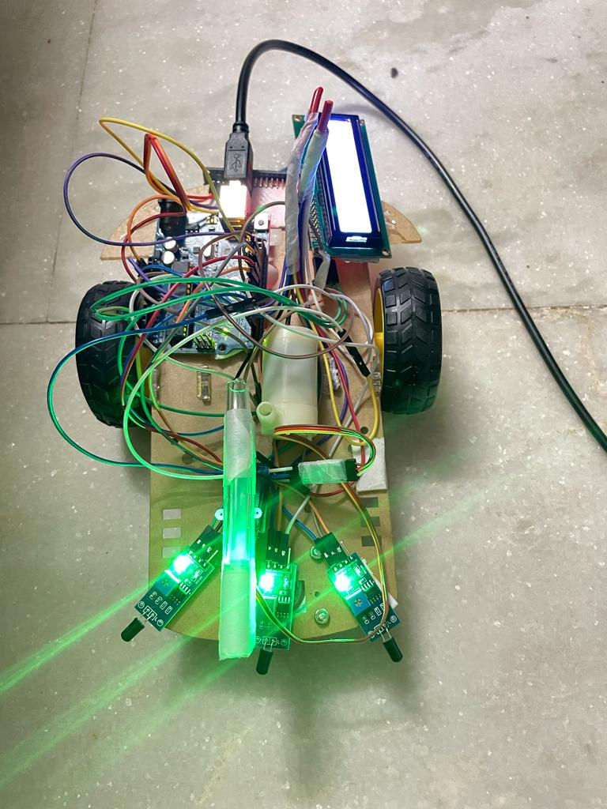
SIMULATION/ HARDWARE
Industrial fire extinguisher project can be implemented either as a simulation or as a hardware project.
Hardware:
A hardware project is a physical implementation of the Industrial fire extinguisher project. This means that you will need to purchase all of the necessary components and assemble them together. This can be a more challenging project, but it can also be more rewarding.

Slide 16
RESULTS
The basic principle of a Industrial fire extinguisher is to use sensors that detect fire and then use actuators to extinguish the fire. The sensors and actuators are controlled by the Arduino microcontroller.
The direction of fire detected by the sensors is displayed on the LCD Display.
The Robot has the Ability to Transfer the data that is displayed on the LCD display to an API using the NodeMCU.
The advantages of an Arduino based fire fighting robot include:
It can automatically detect fire and extinguish it, which can save lives and property.
It is relatively inexpensive to build.It is easy to program and modify.
Overall, an Arduino based fire fighting robot is a promising technology that has the potential to save lives and property. However, there are still some limitations that need to be addressed before these robots can be widely deployed.

Slide 17
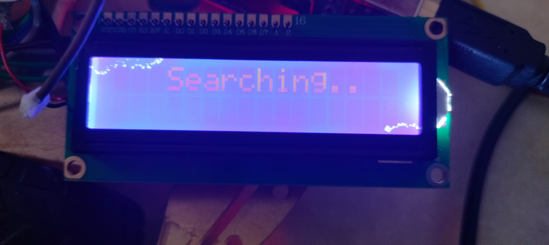
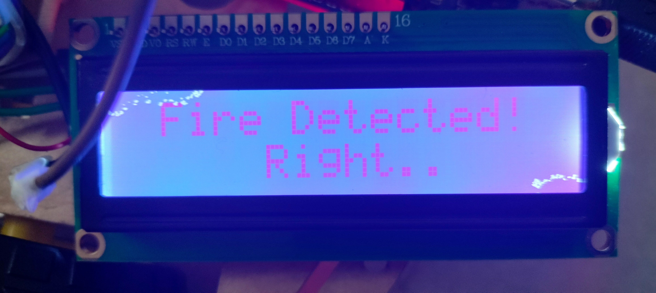
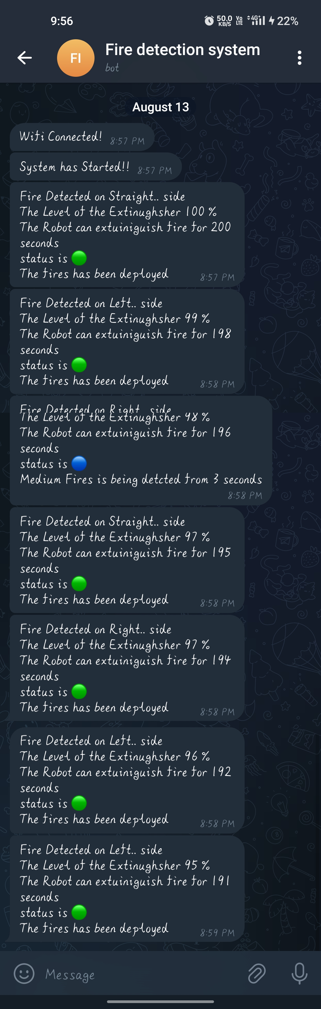
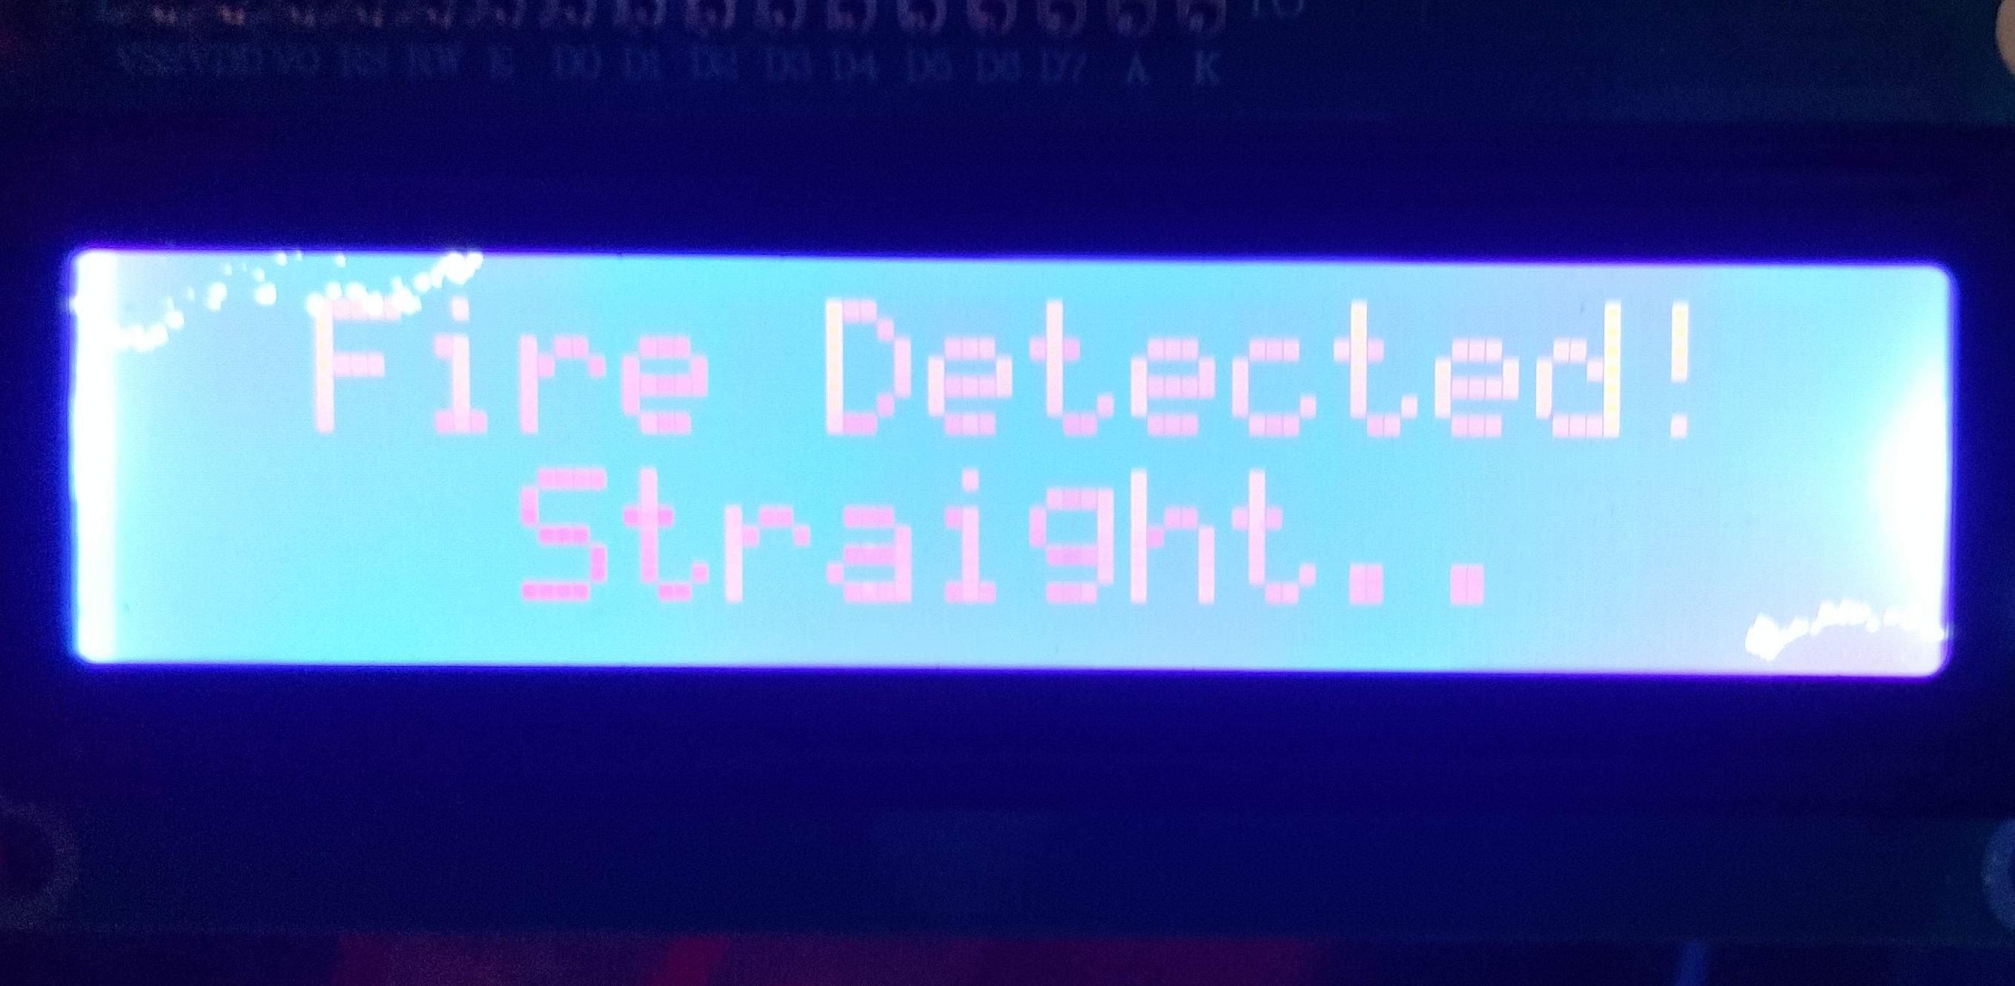
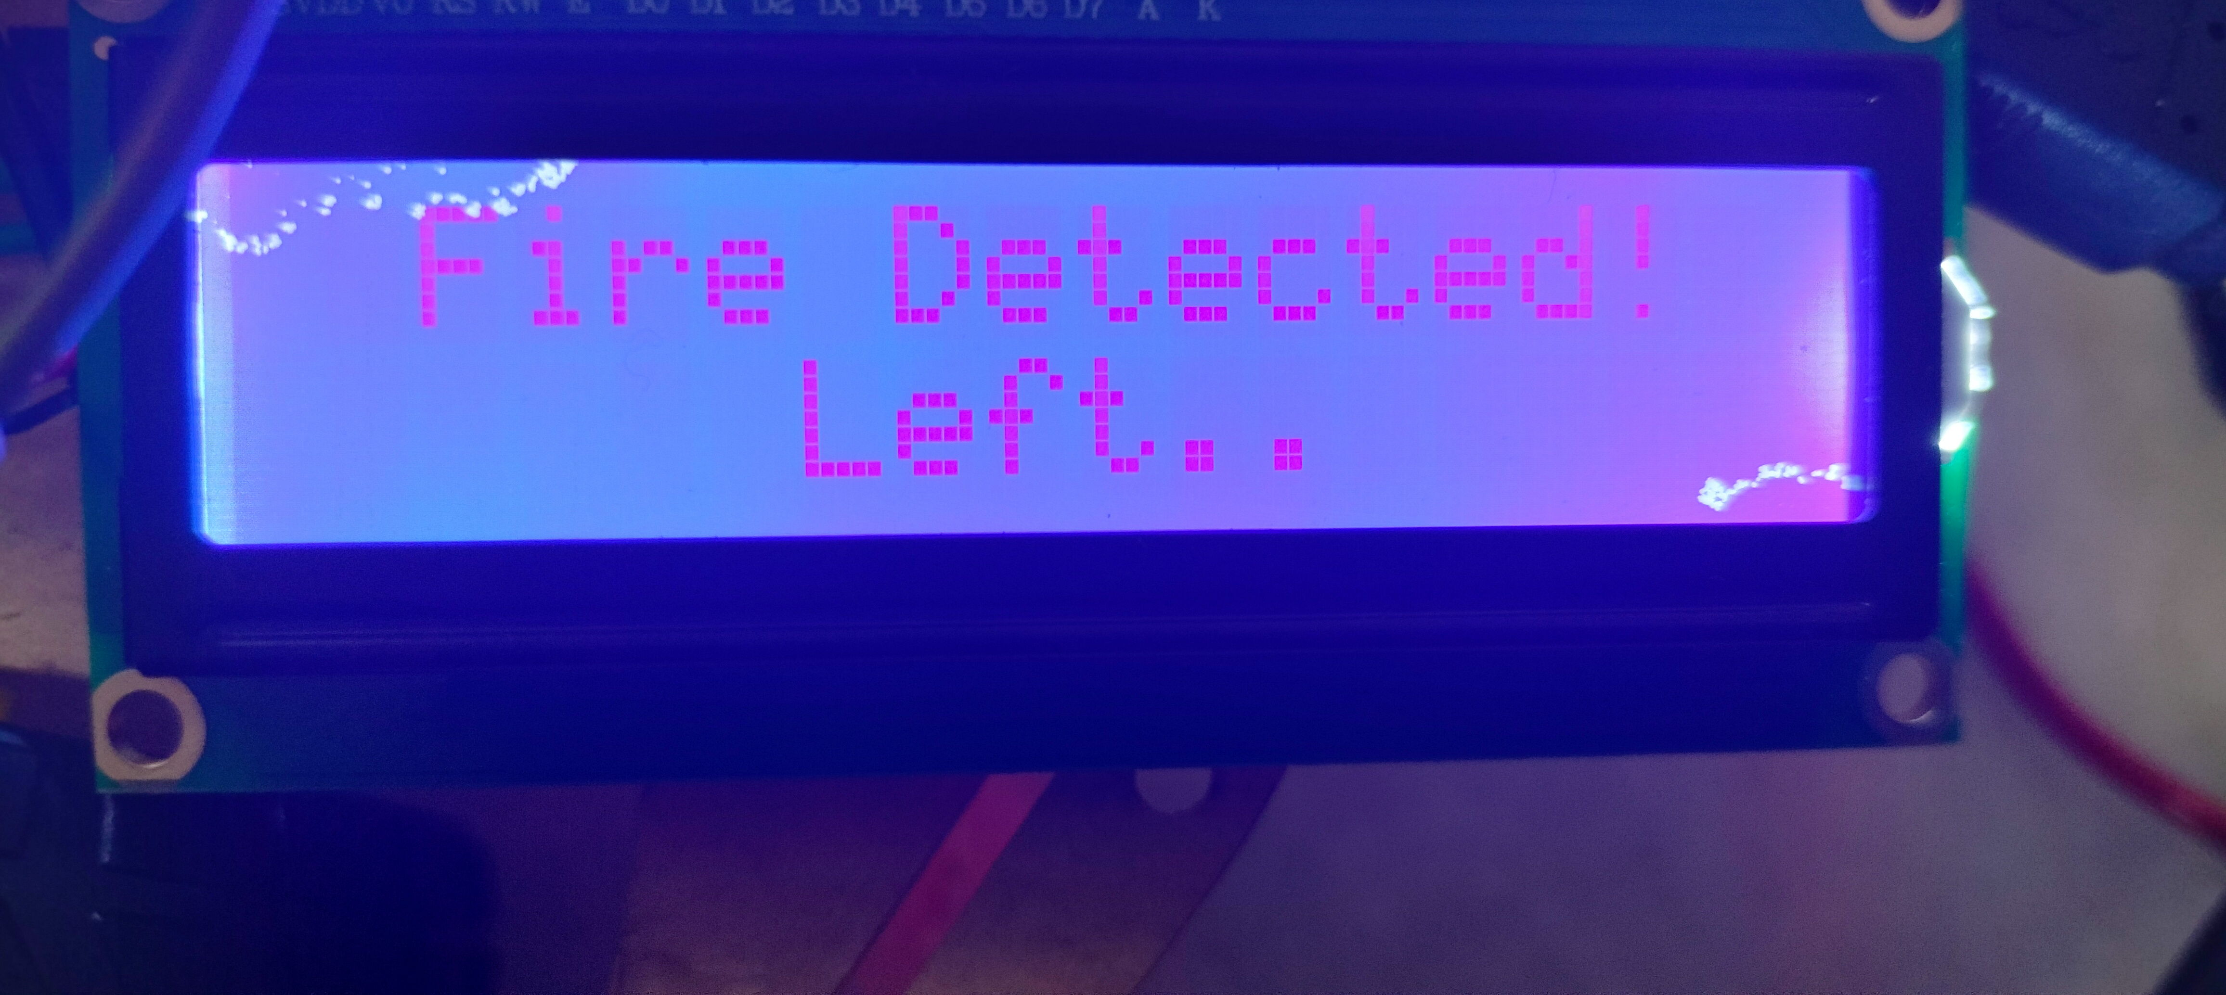
RESULTS

Slide 18
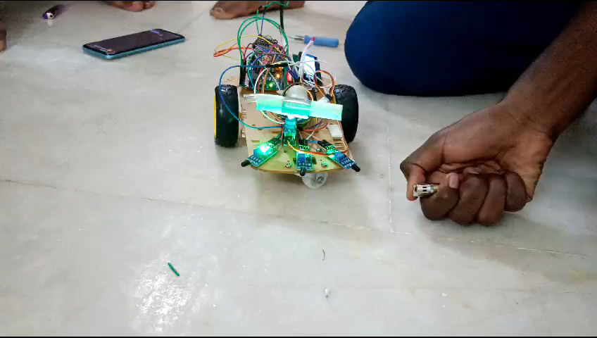
RESULTS

Slide 19
REFERENCES
1.Nagesh, M. S., T. V. Deepika, and Dr M. Shivakumar Stafford Michahial. "Fire Extinguishing Robot." International Journal of Advanced Research in Computer and Communication Engineering 5, no. 12 (2016): 2278-1021.
2.Rakib, Tawfiqur & Sarkar, M. (2016). Design and Fabrication of an Autonomous Fire Fighting Robot with Multisensor Fire Detection Using PID Controller. 10.1109/ICIEV.2016.7760132.
3.A. Viguria, I. Maza, and A. Ollero, "Distributed service-based cooperation in aerial/ground robot teams applied to fire detection and extinguishing missions," Advanced Robotics, vol. 24, no. 1-2, pp. 1-23, January 2010
4. Nivennesh, N., Sathiabalan, L., Lokimi, A. F., Jin, O. Z., Hasrin, N. S., Zain, A. S., Ramli, N., Zakaria, H. L., Ariffin, W. N., Hashim, N. B., & Taib, M. H. (2021). Fire Detection and Water Discharge Activity for Fire Fighting Robots using IoT.
5.Krishna, V. S., & Srinivas, K. S. (2021). Arduino Based Fire Fighting Robot Using Flame Sensor and Water Pump with Obstacle Avoidance.
6."Mathew, S., Sushanth, G., Vishnu, K. R., Nair, V. V., & Kumar, G. V. (2016). Arduino Based Autonomous Fire Fighting Robot.
7.Suresh, K. R., Karthik, J. M., & Kumar, K. J. (2020). Design and Implementation of an Arduino Based Fire Fighting Robot Using Flame Sensor and Water Pump with Obstacle Avoidance.
8.Anoop, M. P., & Suresh, T. P. (2022). Design and Implementation of an Arduino Based Fire Fighting Robot Using Obstacle Avoidance and Fire Detection .
9

Slide 20
REFERENCES
9.Manoj, K. K., Raju, A. V., & Pavan Kumar, K. S. (2021). Design and Implementation of an Arduino Based Fire Fighting Robot Using Obstacle Avoidance and Fire Detection.
10.Ehsan, I., Mumtaz, A., Khalid, M. I., Iqbal, J., Hussain, S., Ullah, S. S., & Umar, F. (2022). Internet of Things-Based Fire Alarm Navigation System: A Fire-Rescue Department Perspective.
11.Kumar, S. S., Farhan, S. M. M., Kumar, V. R. S., & Karthik, M. (2023). Arduino Based Fire Fighting Robot Using IoT and Artificial Intelligence.
12.Kumar, S. S., Farhan, S. M. M., Kumar, V. R. S., & Karthik, M. (2023). Arduino Based Fire Fighting Robot Using IoT and Artificial Intelligence.
13.Priyanka, S. J., & Sangeetha, R. (2018). Design and Implementation of an Arduino Based Fire Fighting Robot Using a Flame Sensor.
14.Kirubakaran, S., Rithanyaa, S. P., Thanavarsheni, S. P., & Vigneshkumar, E. (2021). Fire Extinguishing Robot Using Arduino. Assistant Professor (SR. G), Department of Electronics and Communication Engineering, KPR Institute of Engineering and Technology, Coimbatore, Tamil Nadu, India.
15.Nagesh, M. S., Deepika, T. V., Stafford, M., & Shivakumar, M. (December 2016). Fire Extinguishing Robot.

Slide 21
REFERENCES
16.Vinodhini, S., Akhil, V. M. R., & Sheik Mohamed, S. S. M. (2020). Development of an Autonomous Fire Extinguishing Robot.
17.Sheikh, A., Purohit, G., Raut, V. C., Abdul, R. R., & Kidile, C. H. (May 2022). Arduino Based Fire Fighting Robot.
18.Shobana Maheswari, T. ; Unni, Ambili S.; Baskar, A.Fire fighting robot using LEGO Mindstorm(2015) International Journal of Applied Engineering Research, 10 (8), pp. 20129 - 20138, .
19.Joshna, V. & Kashyap, M. & Ananya, V. & Manitha, P.. (2019). Fully Autonomous Robot to Detect and Degasify Hazardous Gas after Flood Disaster. 134-139. 10.1109/ICPEDC47771.2019.9036703.
20.Kumar, S. S. R., Kumar, R. N. S., & Sheik Mohamed, S. S. M. (2018). Design and Development of a Fire Extinguishing Robot.

Slide 22
CONCLUSION
We finally conclude that,
Main aim of Fire extinguishing robot is to detect fire and extinguish it with the help of necessary components.
When the robot detects the fire it gives a intimation to the controller i.e message and extinguishes the fire.
Arduino-based fire extinguishing robots represent a significant step forward in fire safety technology. However, there are challenges to overcome, such as improving the robots' autonomy, robustness, and scalability, as well as addressing safety concerns. Nonetheless, these studies offer a promising glimpse into the future of firefighting, where intelligent robotic systems play a crucial role in safeguarding lives and property from the devastating effects of fires.

Slide 23
THANK YOU

